Slide 1
DDOS Attack
Problems and Defence Frameworks
Notes:
Hi Everyone,
My seminary talk about the DDOS attack problem and some efficent defence framework that can mitigate it.

Slide 2
Introduction
DDOS attacks is one the major network security threat.
During years was developed many security system against DDOS that protect from specific attacks but not from general attack.
Notes:
Nowadays DDOS is one of the major network security threat and during the years many security systems was developed for specific DDOS attack but no one of those security system can guarantee protection from a general attack.
So we are going to see which feature a good defence framework should have to handle a general DDOS attack.

Slide 3
DDOS: Problem
DDOS attacks occurs when multiple machine generate large traffic volume to a victim occupying resources and so generate a Denial of Service.
Feature of DDOS that can hinder defence:
Large volume
Seemingly legitimate packets
IP spoofing
Notes:
A DDOS attack occurs when multiple malicious machine generates a large traffic volume to a victim with the aim to occupy resources and so generate a denial of service.
DDOS attack is difficult to mitigate because of the following feature that it has :
• LARGE VOLUME: a big traffic volume can overhelm also a defence system.
• SEEMINGLY LEGITIMATE PACKETS: where attack packets can be identical to legit packet and a defence system cannot reach a decision based on individual packet.
• IP SPOOFING: Attacker use a fake source address to disguise defence system

Slide 4
DDOS: Solution
The solution for DDOS attack is to detect it and cut off the attack stream. To successful in this the defence system has to have the following features.
Feature of DDOS defence system:
Accurate Detection
Effective Response
Selective Response
Notes:
The solution for DDOS attack is to detect it and cut off the attack traffic, to do that a defence system has to have those following features:
• ACCURATE DETENCTION: The system must have an high level of accuracy with few false positive attacks
• EFFECTIVE RESPONSE: The system must reduce the attack traffic to handable levels, regardless volume and distribution
• SELECTIVE RESPONSE: The system must be able to differentiate between legit and attack packet ensuring good quality service to legit traffic also during the attacks.

Slide 5
DDOS: Current Defence Paradigm
The current paradigm used from defence system lead to poor performance, it is necessary a paradigm switch.
Current Paradigms:
Autonomous Defence
Distributed Defence
Notes:
The current DDOS defence systems use paradigms that lead poor performance
• AUTONOMOUS DEFENCE: this defence system is composed by one or multiple machine situated in the same network that usually is the victim or intermediate network . In the first case the defence system could be overwhelmed as the victim , in the second case, so in intermediate network, the routers has to analize lot of traffic making difficult a selective response
• DISTRIBUTED DEFENCE : This defence system is composed by nodes that cooperate each other through the internet , but they don't cooperate with other defence systems.

Slide 6
DDOS: New Defence Paradigm
General DDOS threat is still unmitigated so we need new paradigms
New Paradigms :
Node specialization
Heterogeneous cooperative defense
Notes:
Because of general DDOS threat is still unmitigated with the current paradigms, is needed to move to new paradigms to obtain good defence results.
• NODE SPECIALIZATION: in this defence system nodes are specialized if a specific operation and they cooperate to detect and repair attacks, the attack detenction is done by nodes near the victim , the responce by the nodes near the attacker and intermediate nodes identify if a traffic is malicious or legacy.
• HETEROGENEOUS COOPERATIVE DEFENCE: Is an upgrade of node specialization, the problem of defence system is the deploy, to have high persormances is necessary to have high number of nodes distributed in the network. To obtain it is necessary to have nodes from different defence system cooperating.

Slide 7
Distributed framework for DDOS defence
To move from current to new paradigm is needed a new framework, three types of nodes:
Alert generator
Core
Classifier node
The nodes must support the following messages:
Attack alerts
Rate-Limit request
Resource request
Traffic classification
Notes:
To have an efficient DDOS mitigation is so necessary to move from current to new paradigm and to do that a new framework model is defined and it has to have those features.
Three type of different nodes:.
• ALERT GENERATOR: detect the attacks and warn other nodes, it is situeted near the victim.
• CORE NODE: It has to limit the traffic volume directed to a victim
• CLASSIFIER NODE: It has to differentiate the traffic between legit and malicious.
Those node to cooperate with nodes from other defence system must support the following messagges:
• ATTACK ALERTS: warn other nodes about a current attack
• RATE LIMIT REQUEST: each node comunicate to others the rate limit that they have to use
• RESOURCE REQUEST: Each node can request to increase theyr rate limit
• TRAFFIC CLASSIFICATION: Is used by classifier node to inform if a packet is legit or not.

Slide 8
DefCOM
Heterogeneous cooperative defense
Example design of DDOS Heterogeneous defence framework (new paradigm) organized in a peer-to-peer network.
When an attack is detected:
Victim traffic tree creation
Set traffic limit
Differenciate between legit and malicious attack
Notes:
DEFCOM is an example of heterogeneous cooperative defence framework, it works in a peer-to-peer network structure.
During an attack the system create dinamically the victim traffic tree and set traffic limit differentiating between legit and malicious attack.

Slide 9
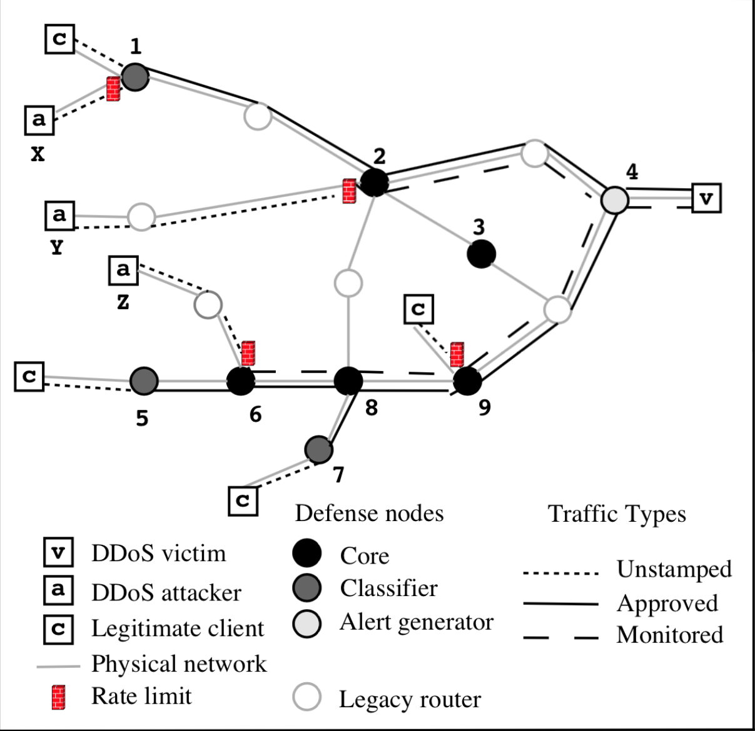
DefCOM: Traffic Tree Discovery
Alert generator node closest to victim detect the attack and send alert message to other nodes.
The others nodes cooperate analysing the traffic to trace the victime traffic tree.
DefCOM has the problem of falsely reporting DDOS attacks, if a malicious user report a false attack the system will decrease the traffic rate limit. This problem is solved by signing the messages.
Notes:
In the figure we can see a standard schema of DefCOM network.
When an attack occur the alert generator node, that is the one closest to the victim, send and alert message to the others nodes.
The others nodes cooperate analysing the traffic and create the victim traffic tree.
A problem of this structure is that a malicious user report a false attack the system will decrease the traffic limit reducing the victim service performance, this problem is solved signing the alert message so that can be trusted.

Slide 10
DefCOM: Distributed Rate Limiting
The nodes cooperate to deploy rate limits that is deployed on the leaf core node of the tree to reduce congestion.
The rate is propagated from root of the leaf downstream, each node assign an equal part of his rate limit to the children via rate-limit request.
The rate limit can be modified by resource request because some child-node may need more bandwidth for legitimate clients.
Notes:
After the tracing of traffic tree ,the nodes cooperate to deploy the rate limits, usually the limit is deployed far from the user on the core nodes to reduce the congestion.
The rate is propagated from the victim to the nodes, each node assign a limit the theyr child-nodes using the rate-limit request message.
If a child node need more bandwidth for legit client it can require it from his parent node via resource request message.

Slide 11
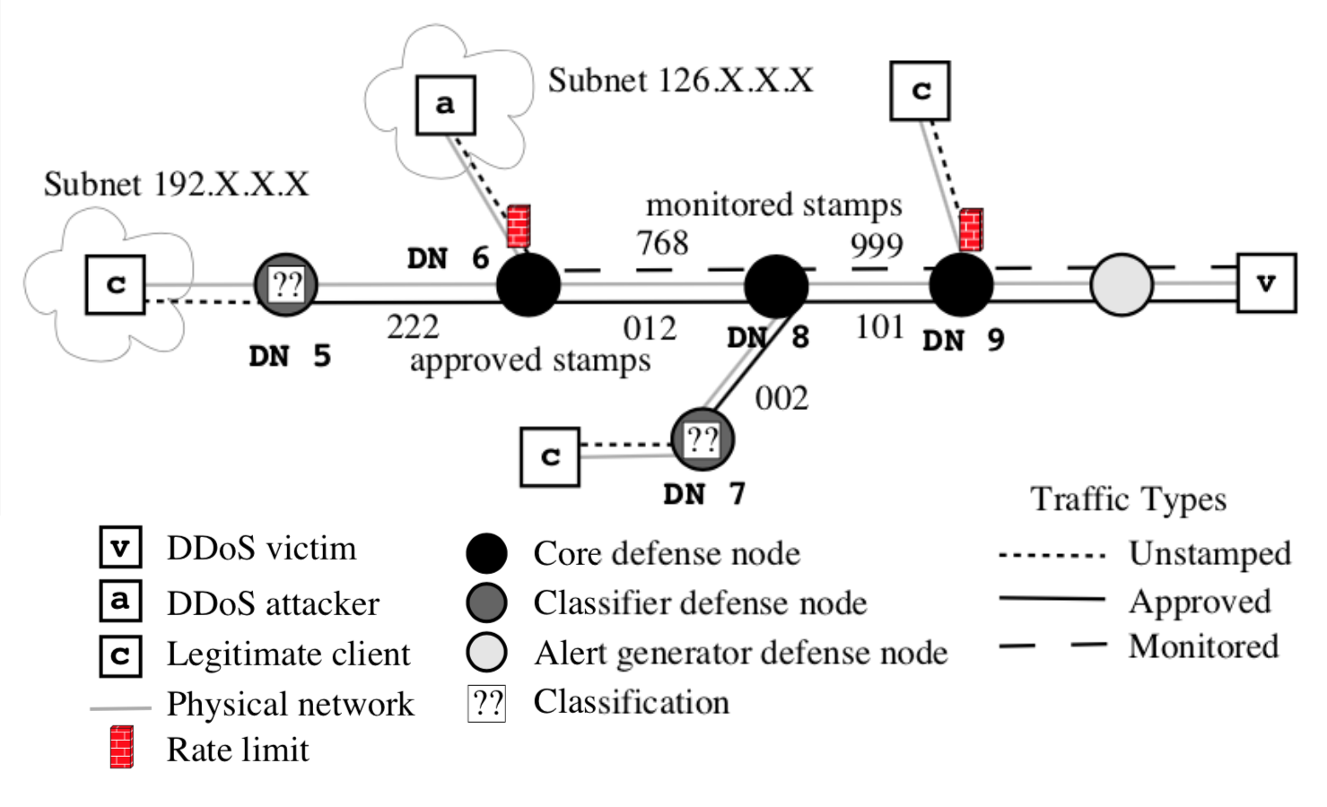
DefCOM: Differentiated Service for Legitimate Traffic
Classifier defense node analyse the packets and if they are legit mark them as approved-traffic.
The traffic that surpass the rate limit in the core nodes are marked as monitored-traffic
Served traffic list in core nodes:
Approved traffic
Monitored traffic
Unstamped traffic
Notes:
To differenciate from legit and attack traffic the classifier defence node mark them with a stamp as approved-traffic if is legit or monitored traffic if it surpass the rate traffic limit in the core nodes.
The traffic is then served in this order:
• APPROVED TRAFFIC
• MONITORED TRAFFIC
• UNSTAMPED TRAFFIC

Slide 12
DefCOM: Framework Security
Not only the victim but also the framework has to be defended by attacks:
Service deny
Attack hiding
Stamp tampering
Notes:
Not only the victim but also the framework has to be defended by malicious node attacks like:
• SERVICE DENY: Malicious node deny service to legit client, it doesn't create too much damage because can't comunicate with brothers node.
• ATTACK HIDING: Malicious node stop the propagation of attack alarms, it can be mitigated using alternative paths:
• STAMP TAMPERING: Maligious node that discover the stamp to mark the packets can mark attack packet as approved, this can also be mitigated incrising the bits of the stamp.

Slide 13
FireCol
Distributed Defence
FireCol is a collaborative distributed defence system (current paradigm) that detects flooding DDoS attacks
FireCol has a distributed architecture composed of multiple IPSs (Intrusion prevention systems) forming a networks of protection rings around subscribed customers.

Slide 14
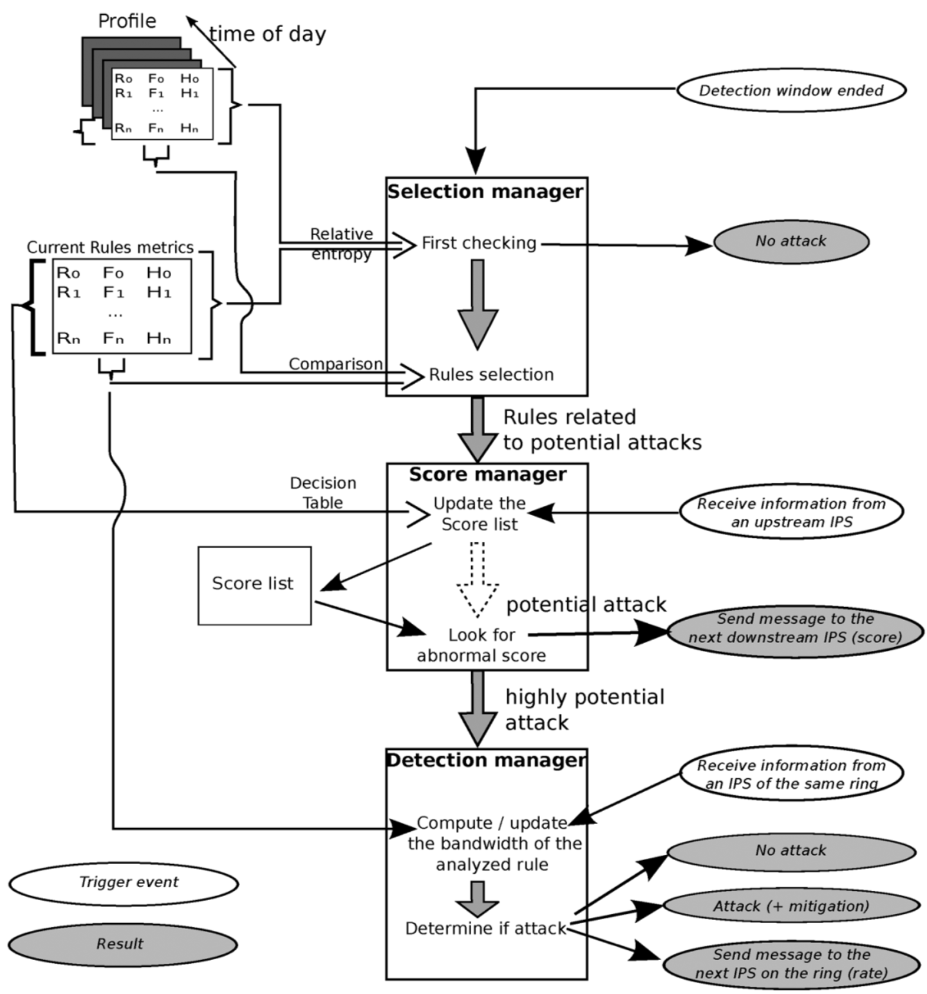
FireCol Architecture: Ring-Based Protection 1
Each IPS instance analyzes traffic with a configurable detection window.
After the selection manager measures the deviation of the current traffic profile from the normal ones, selects the rules (traffic filter) and forwards them to the score manager.
Using a decision table, the score manager assigns a score to each selected rule based on the frequencies, the entropies calculated by metrics manager, and the scores received from upstream IPSs.

Slide 15
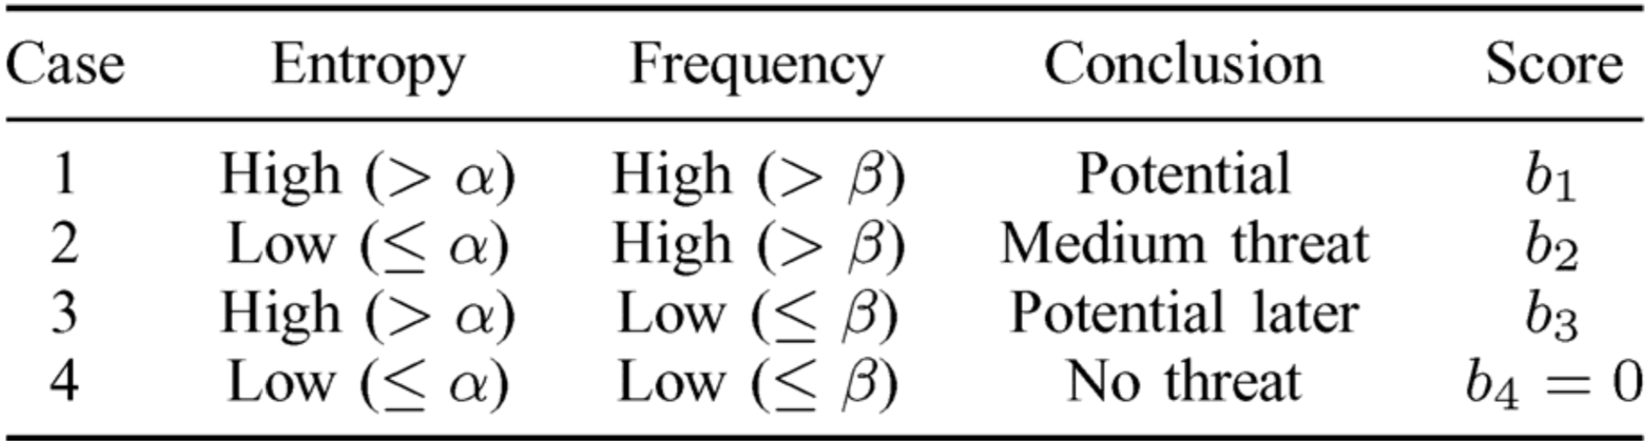
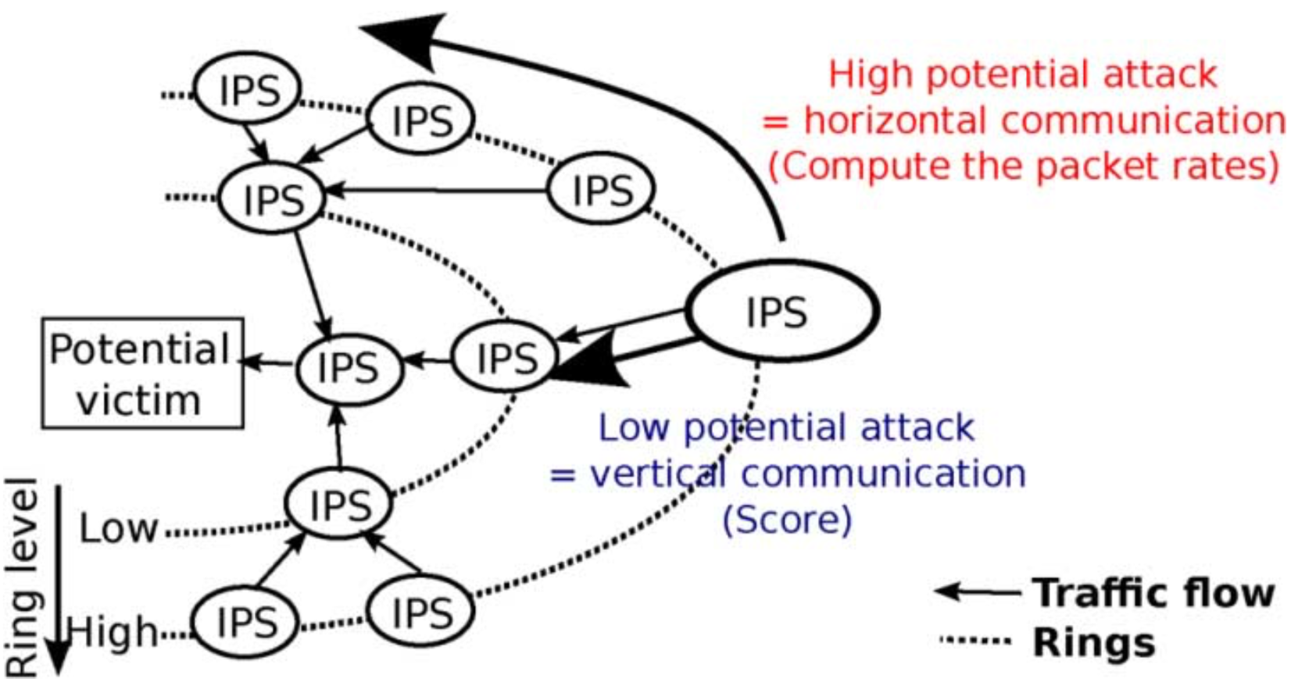
FireCol Architecture: Ring-Based Protection 2
The score for each rules is calculated based on entropy and frequency, the low scored rules are marked as a low potential attack and is communicated to the downstream IPS that will use it to compute its own score.
An high score on is marked as high potential attack and triggers ring-level (horizontal) communication in order to confirm or dismiss the attack.
The detection manager decide if there is an attack in course.
Notes:
packet rate is calculated based on the average traffic of orizontal node.

Slide 16
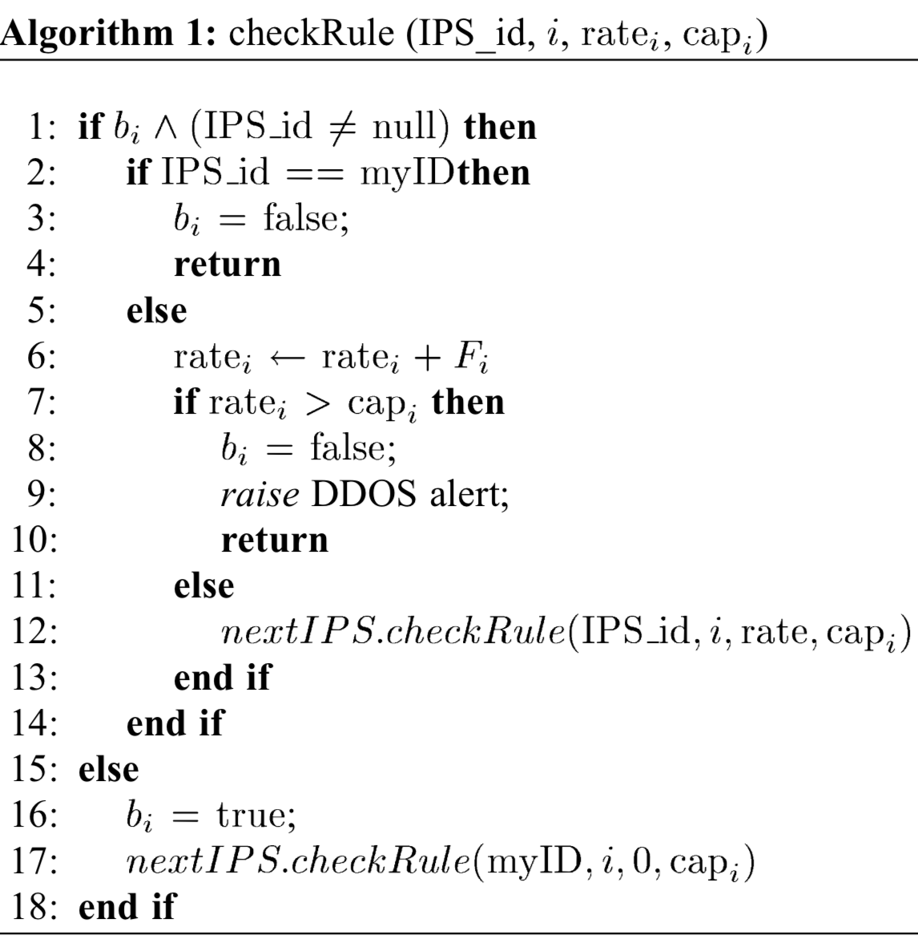
FireCol: Attack Detection Algorithms
The detection manager computes the corresponding packet rate using rule frequencies and the bandwidth consumed during the last detection window and communicate with others node horizontally.
Is bi false? Yes → Start new traffic check , No → Traffic check ongoing.
Is MyID the Initiator? Yes → No attack, No → Adding own rate.
Is max rate reached? Yes → Raised alert, No → Check next ip.
#Check Initiator
#No attack
#Adding current rate
#Attack detected
#Check next IPS
#Starting new traffic checking

Slide 17
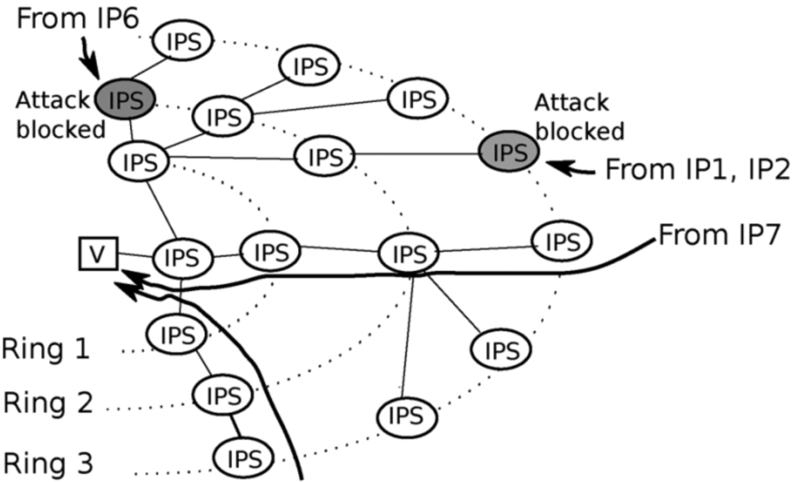
FireCol: Mitigation
When an attack is detected, FireCol form a protection shields around the victim to block the attack.
The IPS that detects the attack informs its upper-ring, which enforce the protection at their ring level.
To extend the mitigation, the IPS that detects the attack informs also the nodes on the same ring to block traffic related to the corresponding rule.
Only traffic from suspected sources is blocked as shown in figure.

Slide 18
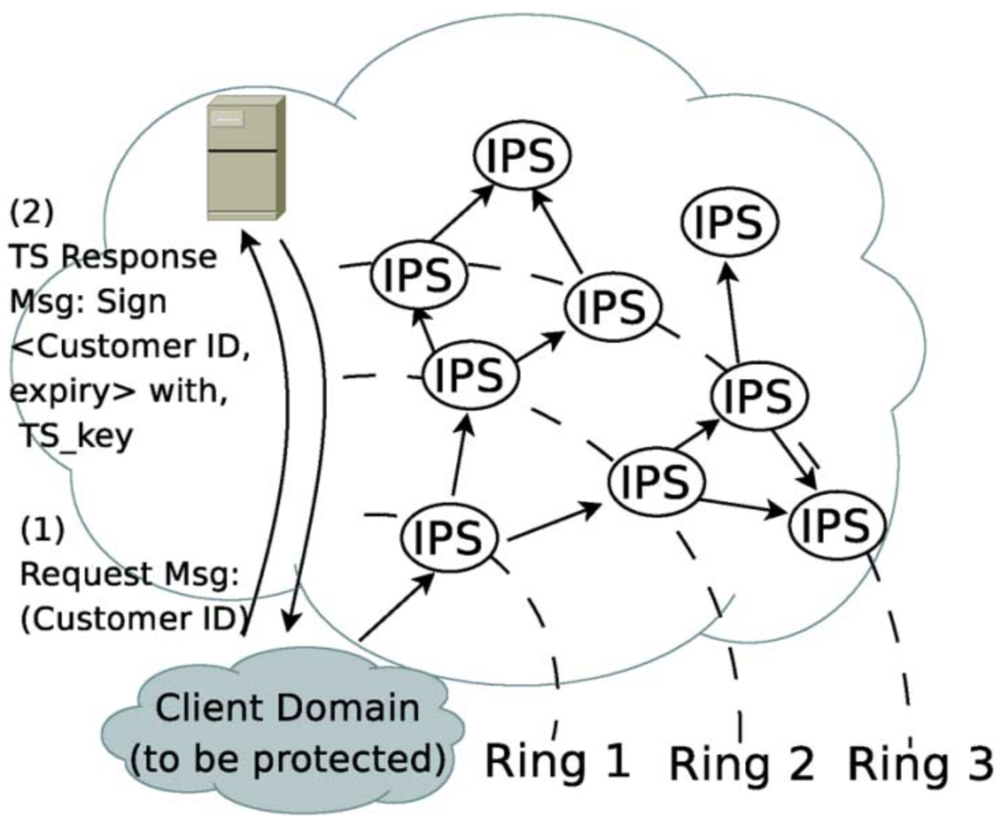
FireCol Architecture: Subscription Protocol 1
Customers can subscribe to FireCol service using the protocol.
When a customer subscribes for the FireCol protection service, the trusted server saves an entry with user ID.
The server then issues periodically a signed token to the user.

Slide 19
FireCol Architecture: Subscription Protocol 2
To build and update the ring network is used a two phase process.
The router sends a message to the customer containing a counter initialized to 0. The counter is incremented each time it passes through an IPS.
The customer then replies to the router with the value of its ring level.
Notes:
The ring level value is strongly network-dependent.

Slide 20
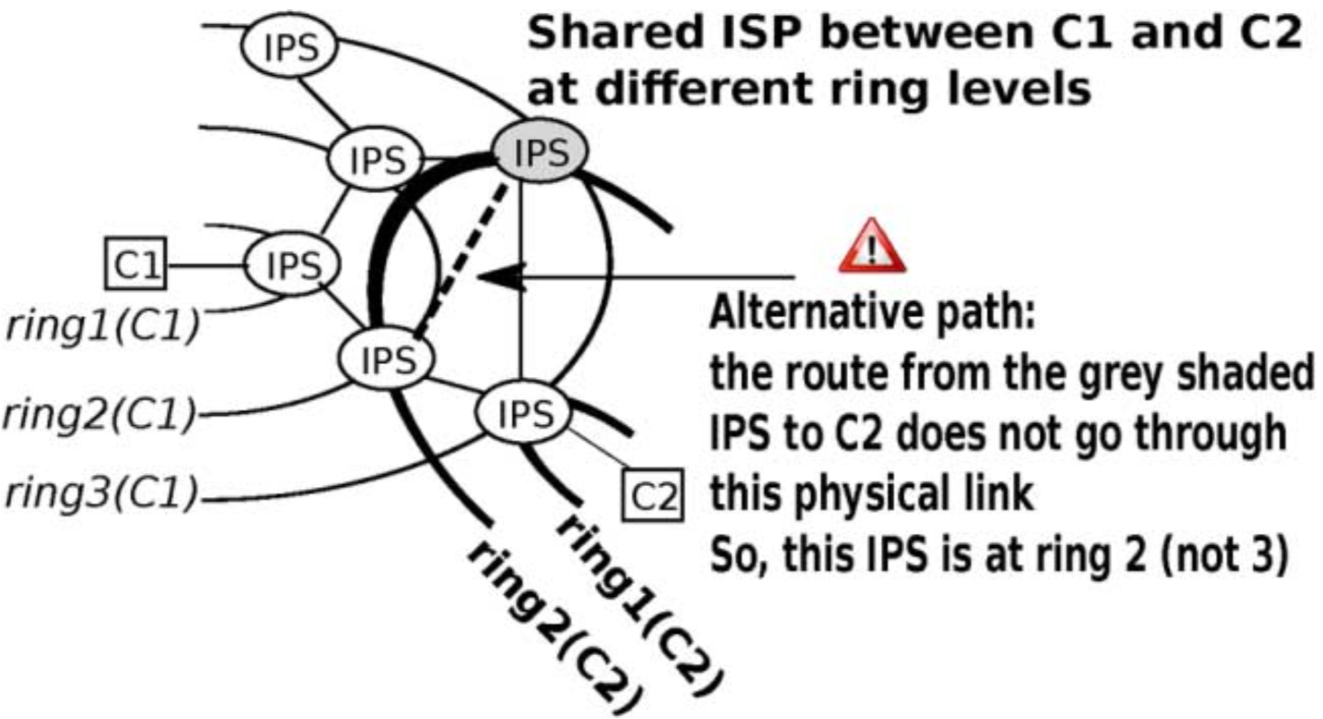
FireCol Architecture: Multiple Customers
FireCol allows the coexistence of multiple virtual protection rings for multiple customers across the same set of IPSs.
A single IPS may work at different levels and path for different customers

Slide 21
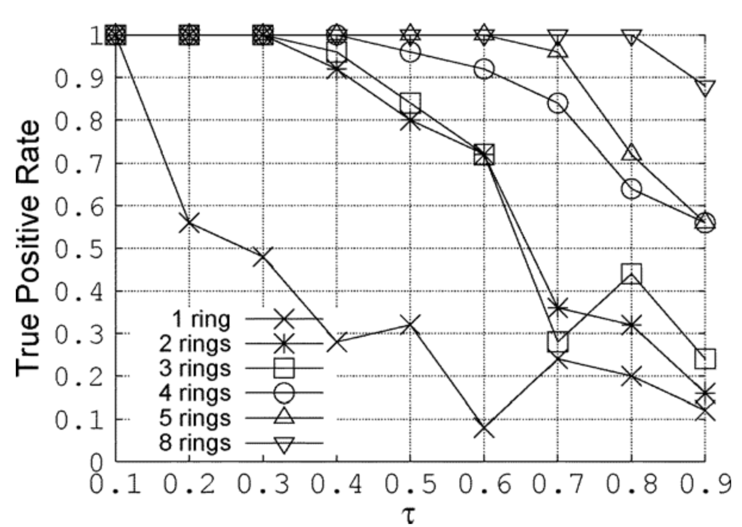
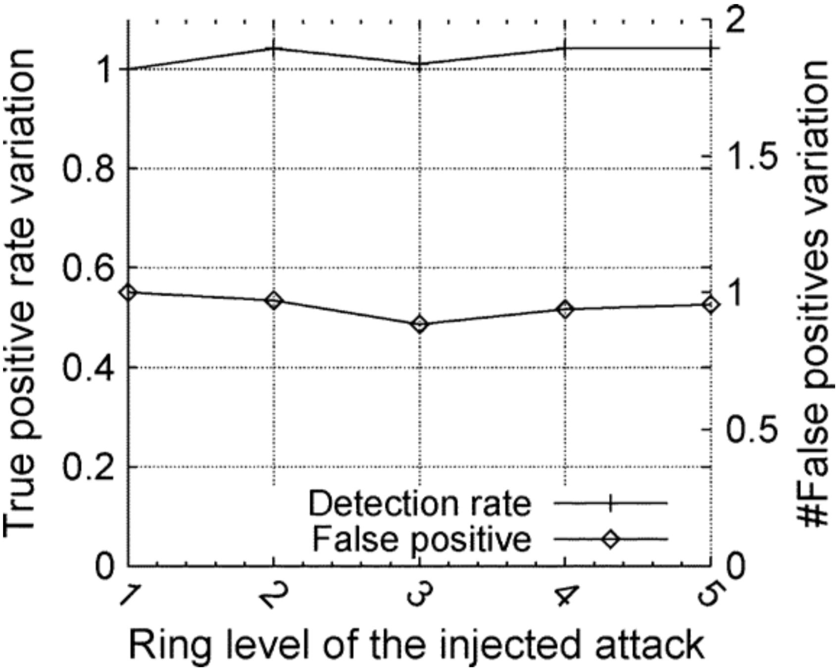
FireCon: Evaluation 1
To evaluate the accuracy of FireCol multiple experiments have been done:
Impact of the score threshold: Want to find the optimal threshold for each topology evaluating the TPR attacks, the purpose is to find the highest threshold value that maintain an high TPR, for example for 5 ring the optimal t value is about 0.7.
Ring level of attack: An attacker might launch an attack in the vicinity of the victim avoiding high-level rings. Instead of decreasing the threshold for detect attack at low-level, the benign traffic is also analyzed by the upper rings, which helps in distinguishing it from the malicious ones.
in Ring 5
Notes:
The second image shows that a five-rings topology can also detect attacks from lower-order rings.

Slide 22
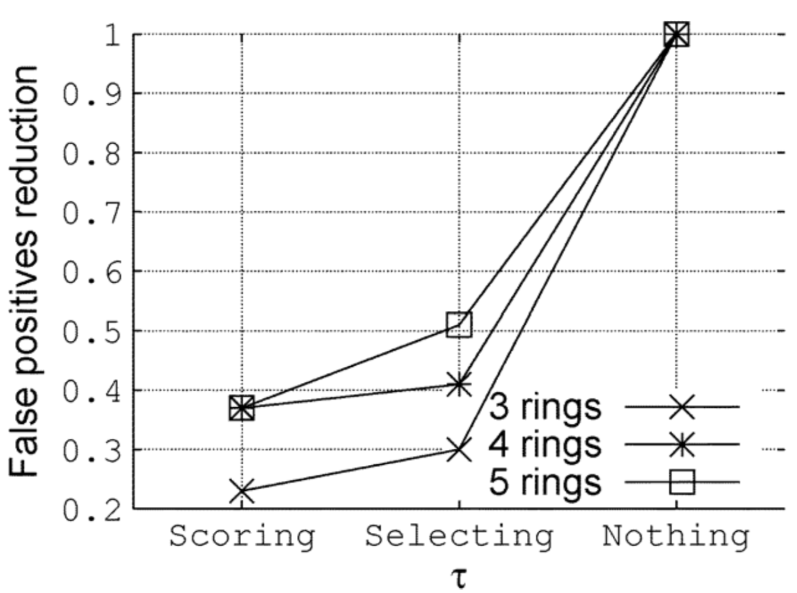
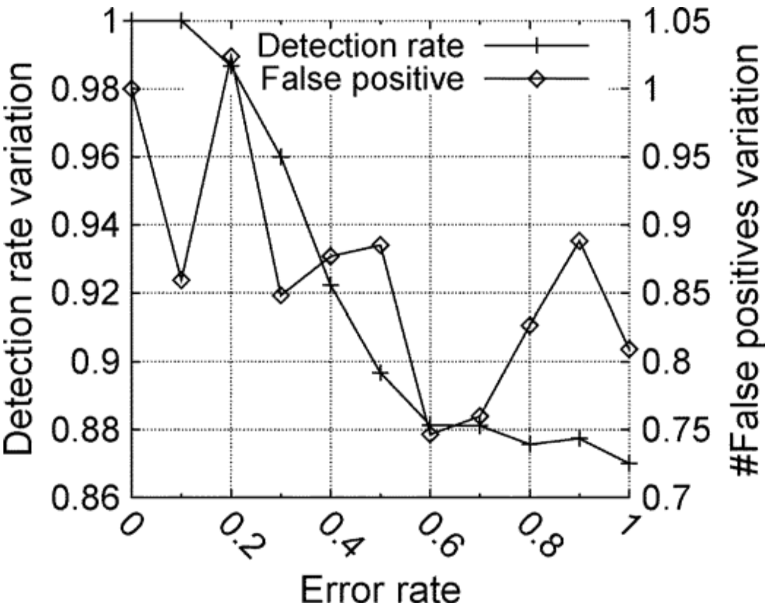
FireCon: Evaluation 2
Efficiency of the MultiLevel Approach: The first value represents the results when both the selection and score managers are enabled. The second value is when only the selection manager is enabled. The selection manager reduces the number of FPs by more than 50%.
Configuration Errors: When an IPS is assigned to the wrong ring it is a configuration error. The TPR is never affected by more than 14% since a misconfigured IPS still continues to send information to another IPS. The variation of FP is more chaotic, however quite limited. This concludes that FireCol exhibits good robustness against configuration errors.

Slide 23
Conclusion
DDOS attack is one of the major security threat that cannot be mitigated by isolated solution.
Various defence system composed by nodes must interoperate exchanging information and services to obtain an high level of security.

Slide 24
Thanks for the attention!

